Slide 1

How does a mouse works
Submitted to :
Dr. Manish Kumar
SeNSE IIT Delhi

Slide 2
Components of a optical mouse
Push Buttons
Optical navigation image sensor
Scroll Wheel
Wireless communication
Lithium-ion Battery
Printed Circuit Boards
System on a chip

Slide 3
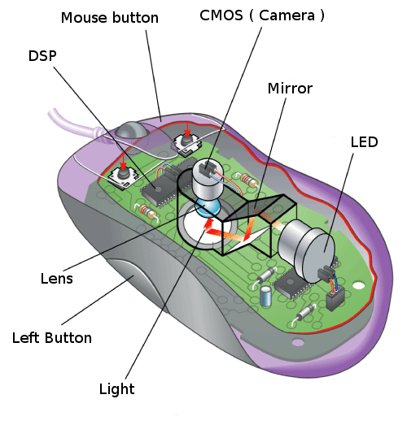

Slide 4
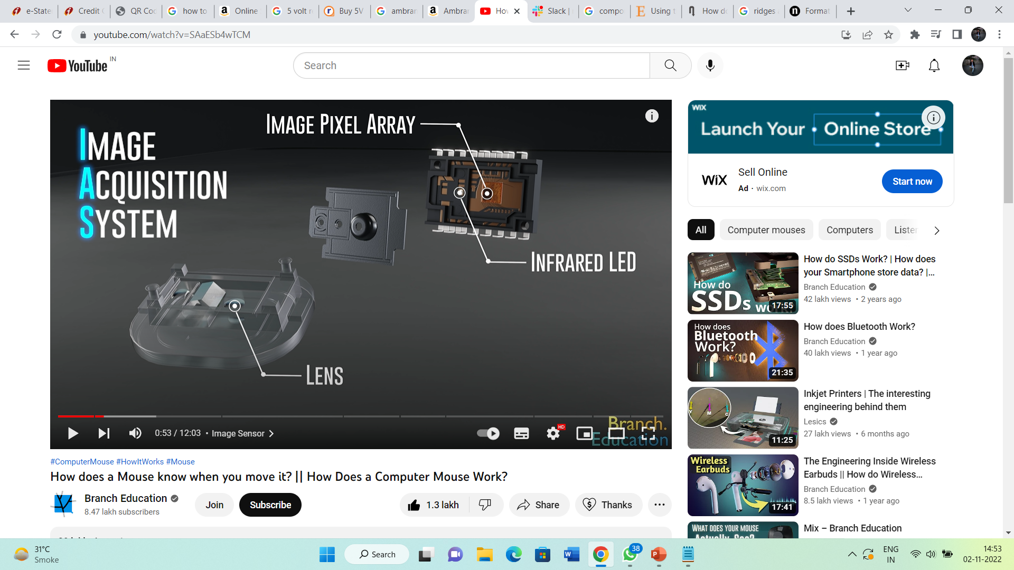
Image acquisition system
It consist of :
1. An infrared LED
2. A pair of lenses
3. Image Pixel Array

Slide 5
Infrared light, generated by the LED, passes through a lens and illuminates the surface directly underneath the computer mouse.
Next, the infrared light bounces off the surface , passes through a second lens, then through a tiny aperture, and finally hits this rather sophisticated image pixel array, or image sensor, which is composed of sixteen hundred pixels, laid out 40 X 40.
NOTE: Mouse doesn’t capture the color or design of the mouse pad or surface.

Slide 6
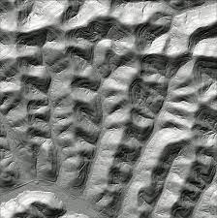
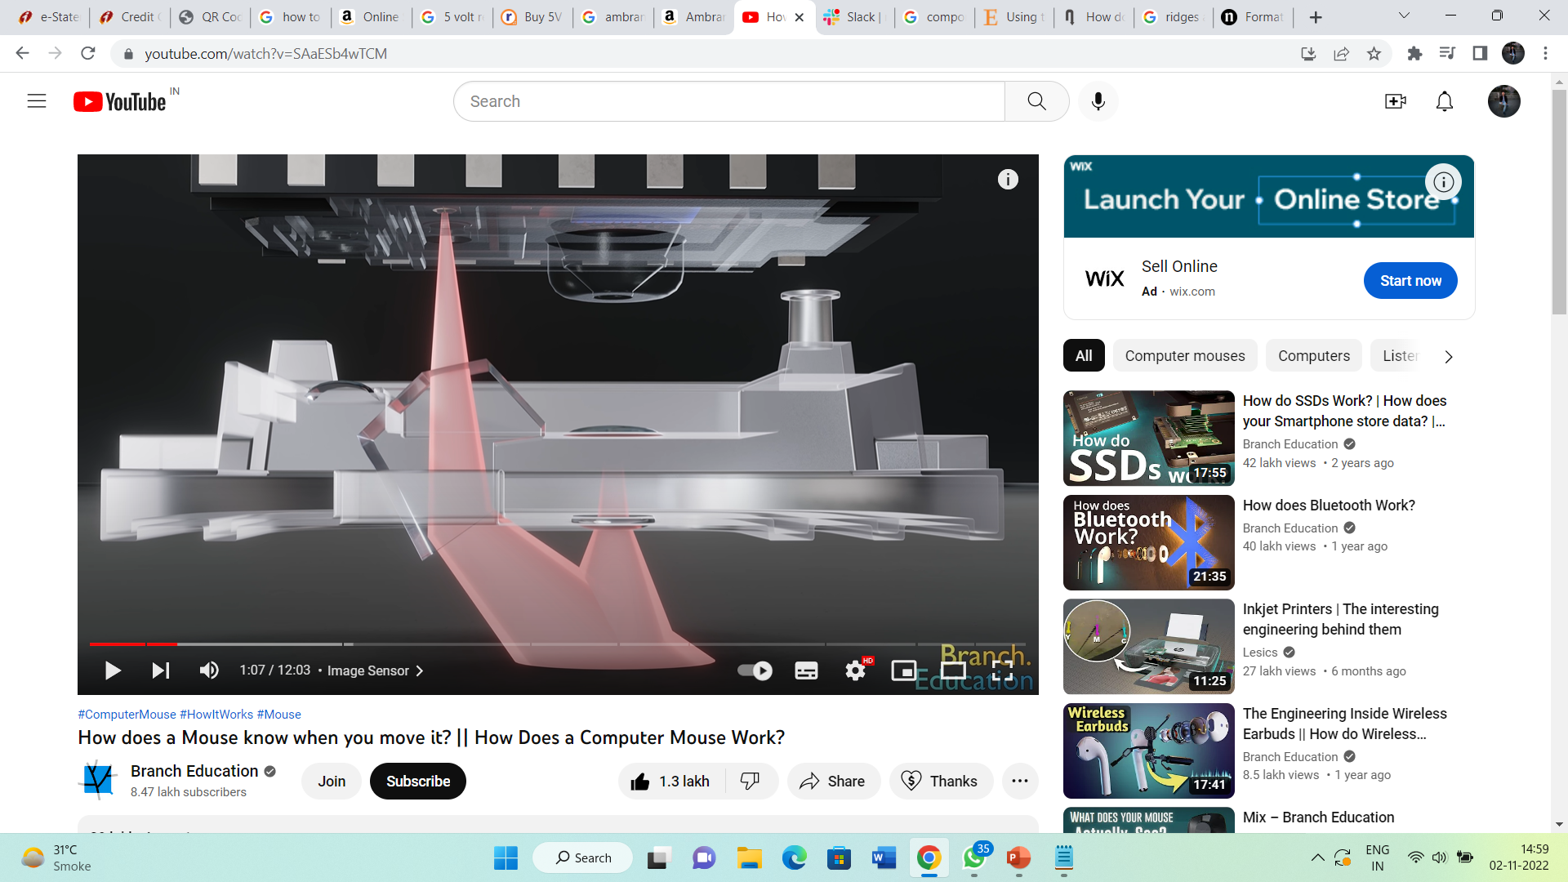
Rather, because the light is emitted at a shallow angle, it illuminates the texture , or the ridges and valleys of the surface , kind of like a sunset falling across rolling hills.
The tops of the hills catch and reflect the light and are illuminated, but the light doesn’t reach into the valleys, and thus they remain dark.
Our eyes might see just a uniform black mousepad or wooden desk, but because of the shallow angle of the infrared light and the focus of the lenses, the image sensor is able to capture a topographically and texturally complex landscape.
Ridges
Valley

Slide 7
Note : If the surface were perfectly smooth with no imperfections, the mouse would struggle to work on it which is the reason why some computer mice don’t work well on glass.

Slide 8
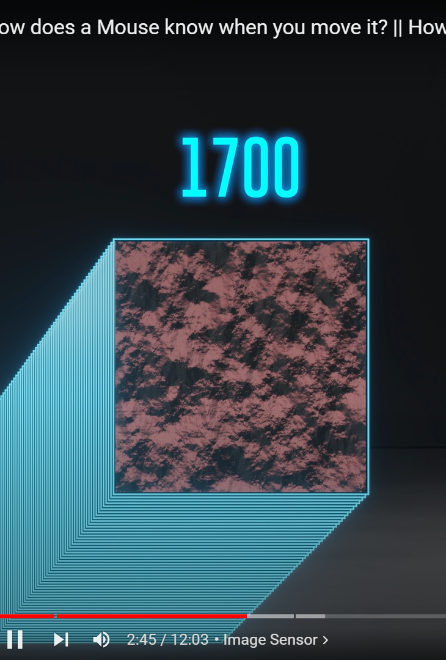
This image sensor with its 1600pixels focuses only on a tiny area just 1/200 the size of a penny, immediately below the mouse.
However, the key is that the image sensor takes up to 17,000 pictures of the surface every single second, and thus, even if you move your mouse across the mousepad for just a tenth of a second, the image sensor would take around 1700 pictures during that quick move.

Slide 9
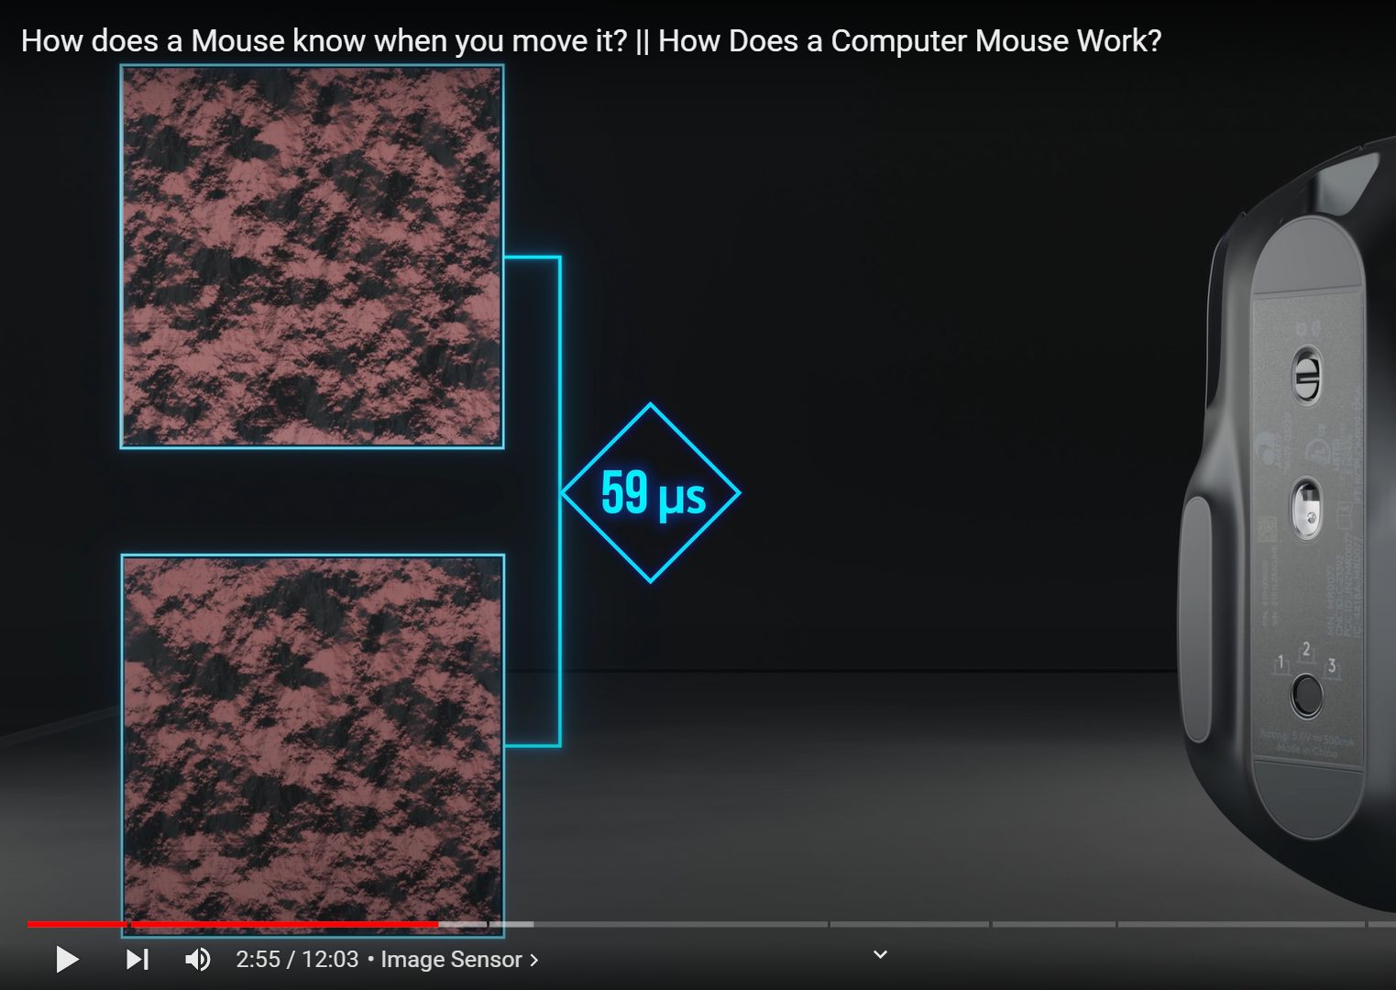
Mouse doesn’t save any of these images ,but rather, every time it takes a picture, it compares it to the previous one taken 59microseconds earlier .
The microchip then uses the difference between the two images in order to determine the change in X and change in Y, or in essence how far and in what direction you moved your mouse in that one seventeen-thousandths of a second or 59 microseconds.

Slide 10
If we have two images of the topographical texture of the surface taken 59 microseconds apart, how exactly does the microchip determine the change in X and the change in Y between them?
To calculate this, the two images are sent to a section of the microchip called the digital signal processor, or DSP for short, where an algorithm called cross-correlation is executed.

Slide 11
